Slide 1
Nutrition Knowledge Survey
Katherine Wang, Victoria Ruan, and Jane Yang
06/02/2019
Mr.Lian-AP Statistics

Slide 2
Executive Summary
The project uses a survey of nutrition knowledge test to evaluate students' level of understanding basic nutrition knowledge. Results come from multistage sampling of total 85 students from three grades. We have found the 95% confidence interval of mean nutrition knowledge test score for the population, all students in Dalian Mapleleaf High School Girls' Campus. We have also found the percentage of students in different levels of understanding of nutrition knowledge.

Slide 3
Summary of Research Questions
Our nutrition knowledge survey is adapted from GENERAL NUTRITION KNOWLEDGE QUESTIONNAIRE from Behavioral Science and Health Center of University College London. Our survey questions test students' knowlege on dietary advice considered by experts, nutrients contained in different foods, healthy choices of foods, and how dietary habits are related to diseases. There are in total 10 mutiple choices in our survey. Each question has only one correct answer. Each correct answer is worth 1 point. The full mark is 10.

Slide 4
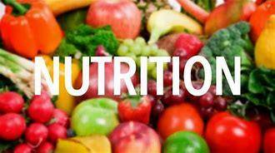
Why selected this topic?
The purpose of the nutrition knowledge survey is to examine students' understanding of basic nutrition knowledge.
The survey will provide information for the Maple Flavor WeChat app development project, which aims to facilitate communication between students and cafeteria and promote healthy diets in campus.

Slide 5

Demographic Overview
population: all students from Dalian Mapleleaf High School Girls' Campus
sample: 10.4(30 gilrs), 11.2(30 girls), 12.9(25 girls)
cluster 1
stratum 1
Grade 10
10.4
stratum 2
cluster 2
Grade 11
11.2
stratum 3
cluster 3
Grade 12
(except international class)
12.9

Slide 6
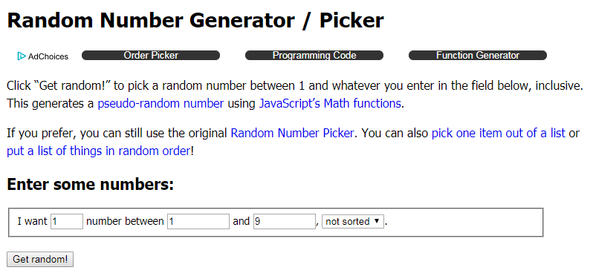

Slide 7
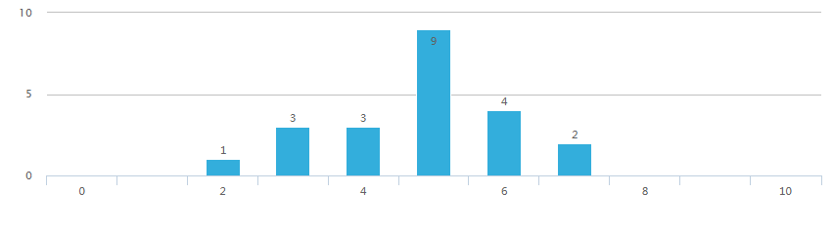
Grade 10 Response Stats Summary
- shape: the graph is fairly normal. There is a peak at 5 as 9 out of 22 people correctly answered 5 questions.
- mean: 4.82
- median: 5
- standard deviation: 1.296014537
- Q1 = 4
- Q3 = 6
- IQR = 2
Sampling Distribution for total nutrition score of Grade 10

Slide 8
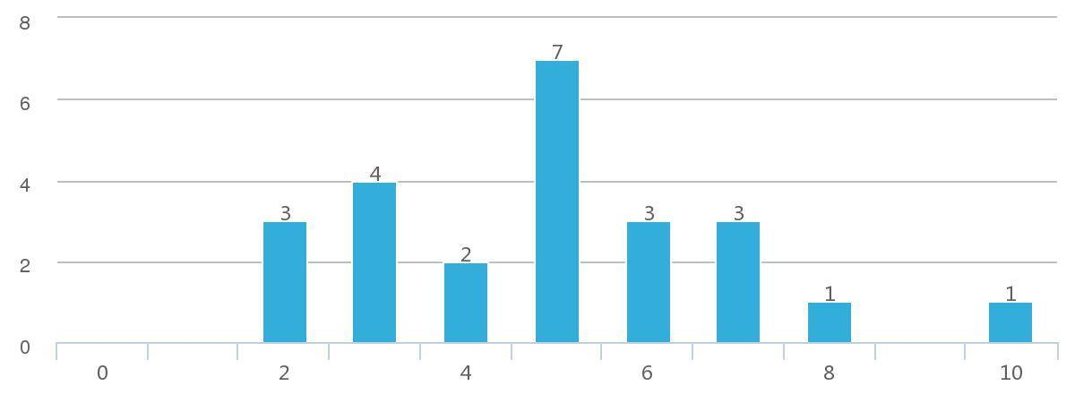
Grade 11 Response Stats Summary
Shape: The graph is approximately Normal with peak at 5
Mean: 4.917
Median: 5
Q1: 3
Q3: 6
IQR: 3
Standard Deviation: 2.0198
95% Confidence Interval: (4.1086 5.7248)
Sampling Distribution for total nutrition score of Grade 11

Slide 9
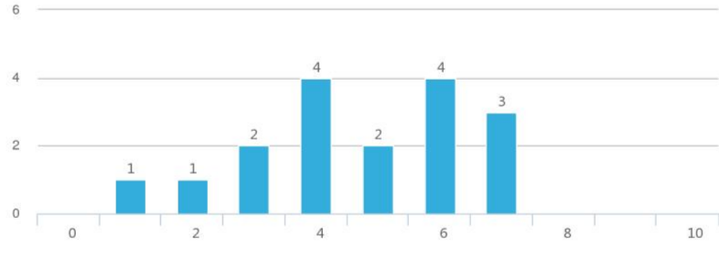
Grade 12 Response Stats Summary
shape: strongly skewed to the left
mean: 4.705
median: 4
Q1:3.5
Q3:6
Due to the unnormal shape, confidence interval cannot be calculated.
Sampling Distribution for total nutrition score of Grade 12

Slide 10
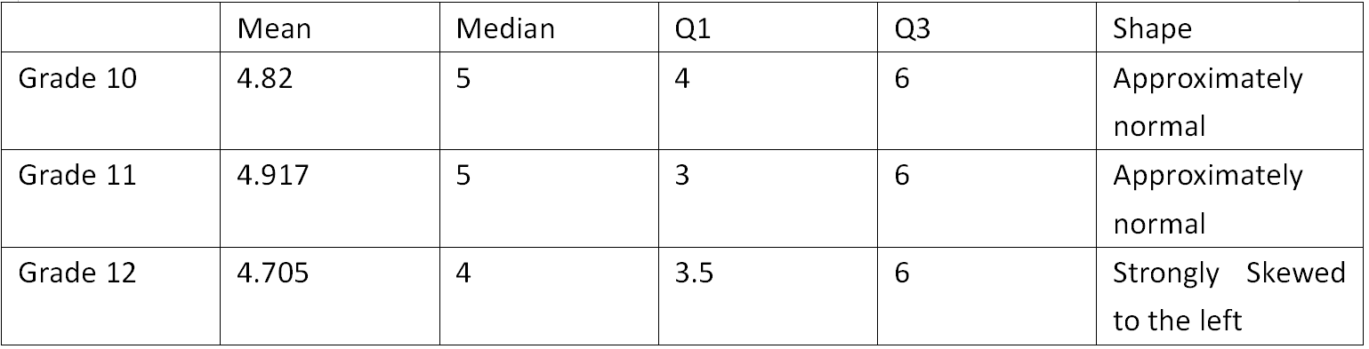
Comparison Between Three Grades

Slide 11
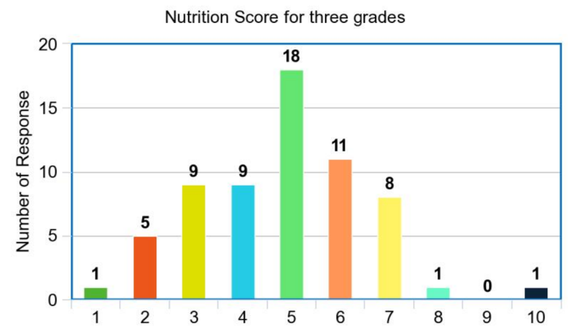
95% confidence interval for mean score of 3 grades combined
Assess the condition:
Random: All clusters are randomly selected
10%: Our sample size is 85. There are at least 850 students in MLES' Girls Campus
Normal: The graph is approximately normal.
We are justified to calculate the one sample t-interval for population mean!
nutrition survey score

Slide 12
Confidence Interval and Interpretation
mean: 4.825
standard error: 1.709
df=63-1=62
confidence interval: (4.406, 5.244)
Interpretation:
We are 95% confident that the interval from 4.406 to 5.244 captures the true mean score of nutrition knowledge test of students in Dalian Maple Leaf International High School Girls' Campus.
nutrition survey score

Slide 13
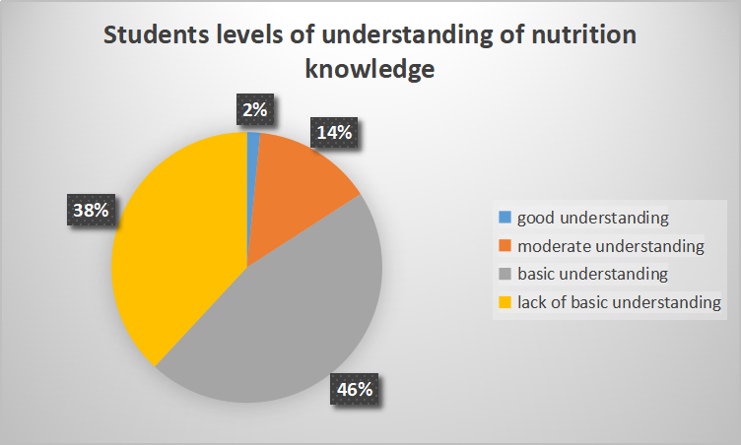
Interpretation
Among all students in Dalian Mapleleaf High School,
1.59% of them have a good understanding of nutrition knowledge(score at least 9)
14.29% of them have a moderate level of understanding of nutrition knowledge(score 7 or 8),
46.03% of them have basic understanding of nutrition knowledge(score 5 or 6),
38.10% of them lack basic understanding of nutrition knowledge(score less than 5)

Slide 14
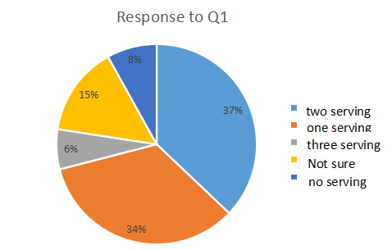
Question 1
If a person has two glasses of fruit juice in a day, how many of their daily fruit and vegetable servings would this count as?
correct answer: one serving
correct percentage: 34%
Interpretation:
Only a minority of students(34%) know one glasses of fruit juice in a day count as two serving of fruit and egetable.

Slide 15
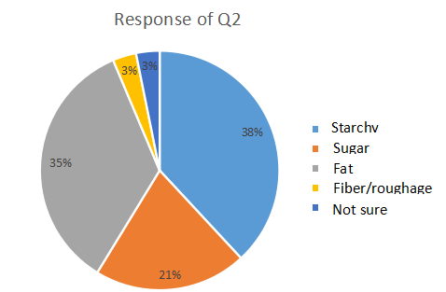
Question 2
Which one of the following nutrients has the most calories for the same weight of food?
correct answer: fat
correct percentage: 35%
Interpretation:
Only a minority of students(35%) know fat has the most calories for the same weight of food.

Slide 16
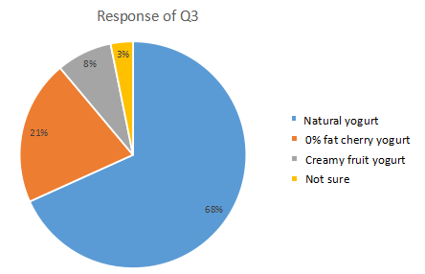
Question 3
If a person wanted to buy a yogurt at the supermarket, which would have the least sugar/sweetener?
correct answer: natural yogurt
correct percentage: 68%
Interpretation:
There is a majority of students(68%) know natural yogurt in the supermarket is the sweetest.

Slide 17
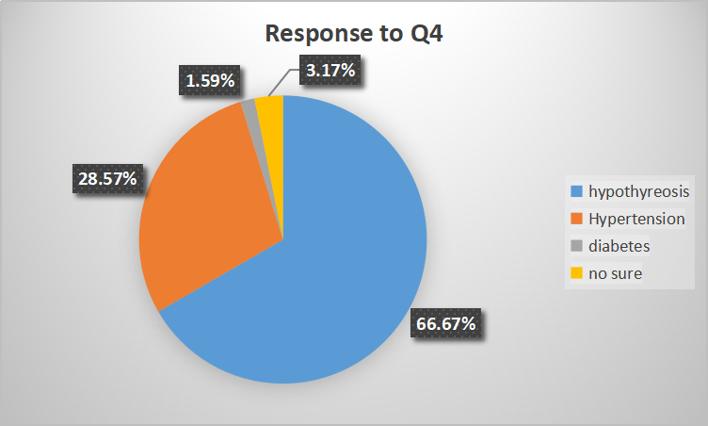
Question 4
Which of the diseases is related to how much salt (or sodium) people eat?
correct answer: high blood pressure
correct percentage:28.57%
Interpretation:
Only a minority of students(28.58%) know how the consumption of salts is related to hypertention.

Slide 18
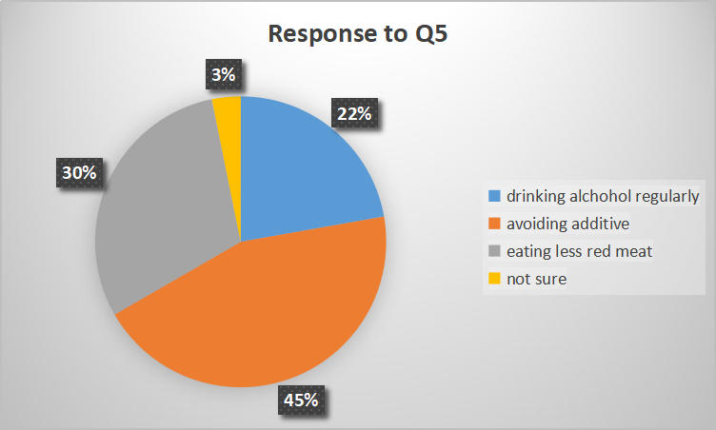
Question 5
Which of these options do experts recommend to reduce the chances of getting cancer?
Correct Answer: Eating less red meat
Correct Percentage:30%
Interpretation:
Only a minority of students(30%) know about how dietary habit is related to chances of getting cancer.

Slide 19
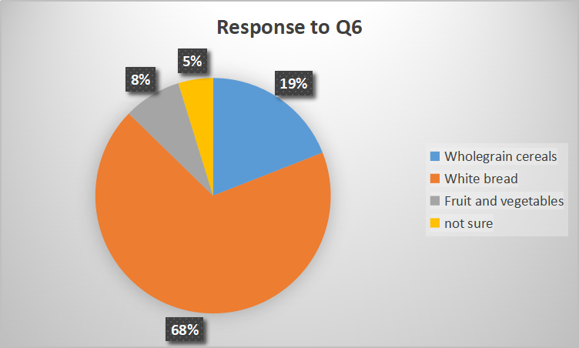
Question 6
Which one of these foods is classified as having a high Glycaemic Index (Glycaemic Index is a 8 measure of the impact of a food on blood sugar levels, thus a high Glycaemic Index means a greater rise in blood sugar after eating)?
Correct Answer: White bread
Correct Percentage: 68%
Interpretation:
The majority of students(68%) know about the comparison of Glycaemic Index between common foods.

Slide 20
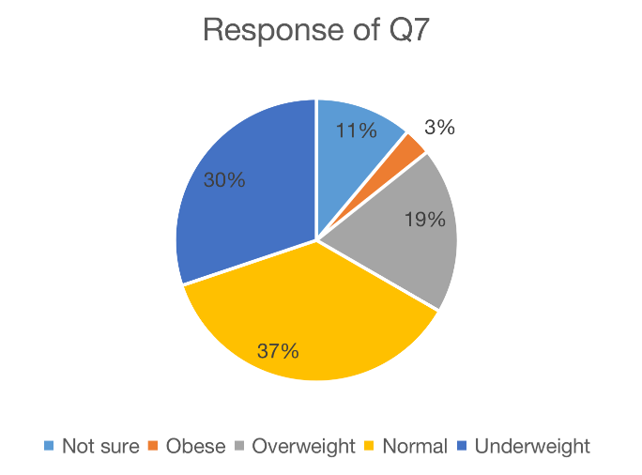
Question 7
If someone has a Body Mass Index (BMI) of 23kg/m^2 , what would their weight status be?
Correct Answer: Normal
Correct Percentage: 37%
Only a small proportion(37%) of students have correct understanding of BMI.

Slide 21
BMI Formula: weight (kg) / [height (m)]^2
BMI Table
Underweight: <18.5
Normal: 18.5 to <25
Overweight: 25 to <30
Obese: >30

Slide 22
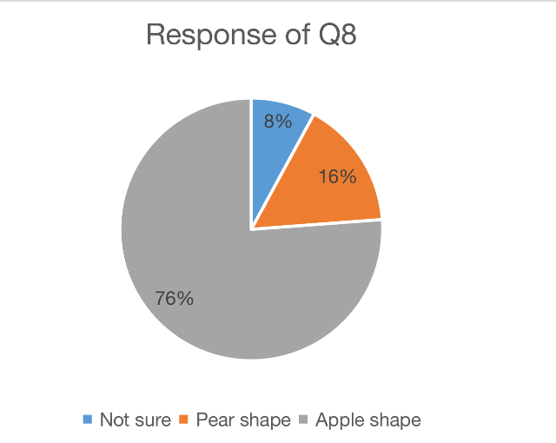
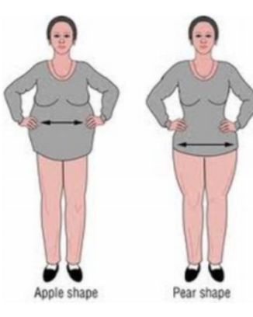
Question 8
Look at the body shape below: Which of these body shapes increases the risk of cardiovascular disease (Cardiovascular disease is a general term that describes a disease of the heart of blood vessels, for example, angina, heart attack, heart failure, congenital heart disease and stroke)?
Correct Answer: Apple Shape
Correct Percentage: 76%
The majority (76%) of students can distinguish the difference on health of two body shape

Slide 23
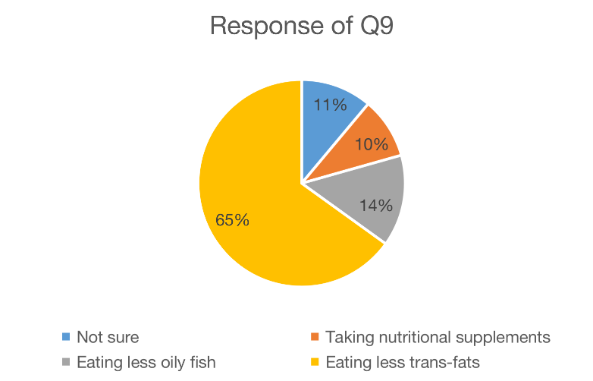
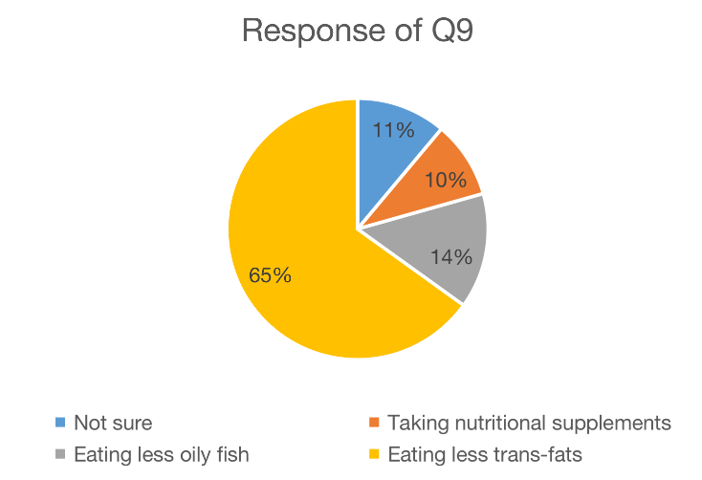
Question 9
Which of these options do experts recommend to prevent heart disease?
Correct Answer: Eating less trans-fat
Correct Percentage: 65%
The majority(65%) of people know the harmful effect of trans-fat on heart.

Slide 24
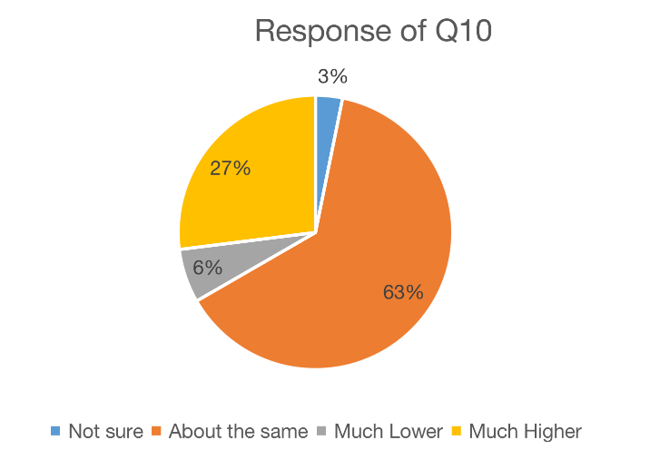
Question 10
The amount of calcium in a glass of whole milk compared to a glass of skimmed milk is:
Correct Answer: About the same
Correct Percentage: 63%
The majority(63%) of people know that there is actually no difference between calcium in whole and skimmed milk.

Slide 25
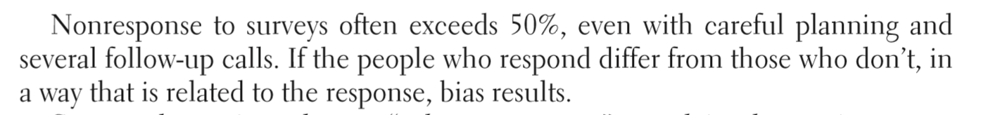
Potential Sources of Bias
1 nonresponse bias:
63 out of 85(our sample size) responded. The nonresponse rate is 25.9%, which is relatively low.
（The Practice of Statistics for AP Exam)
2 carelessness when responding:
eg. 12.9 respondents were reluctant to respond. They might randomly chose answers instead of carefully responding.
3 undercoverage bias:
international students are not included in our sample.

Slide 26

Suggested Changes
1. Use WeChat program to improve nutrition literacy through health related articles

Slide 27
Suggested changes
2 Student union can organize activities that involve learning of nutrition knowledge.

Slide 28

Suggested Changes
3. PE class or Planning class can incldue nutrition knowledge to help students form basic understanding of healthy diets.

Slide 29
Suggestions for future surveys
1 Use the same strategy to keep a low nonresponse rate
2 Reduce undercoverage bias:
Include both Chinese and English versions of surveys so that international students can be included in our sample.

Slide 30
Thank you!
Katherine Wang, Victoria Ruan, Jane Yang
06/02/2019
Mr.Lian-AP Statistics

